Slide 1
Tax Increment Financing 101
Melissa Harrell,
City Administrator
City of Wahoo

Slide 2
Course Objective
This course will provide a basic understanding of what tax increment financing is, and concepts associated with how it is used. This will include a review of the process from beginning to end, understanding of commonly used terminology, examples of projects, and suggestions for Clerks on how to keep everything organized throughout the life of a project.

Slide 3
What we will be covering in this session:
Our authority to provide TIF
What is TIF (Tax Increment Financing)?
Preparing for TIF in your community
Project development and management
After the project is completed
Reporting requirements
Micro TIF
Examples

Slide 4
authority

Slide 5
Nebraska State Constitution Article VIII-12

Slide 6
What Authority are we given?
Nebraska Revised Statutes § 18-2101 to §18-2157
Also known as “Community Development Law”
Being a Dillon’s Law state, as a city or village we can only do what we are given permission to do.
All regulations associated with TIF are contained in these sections.
Legislature is continually tweaking them. Read/review them every time.

Slide 7
In Nebraska
TIF is used to address truly blighted properties
BUT, also one of the only plays in our community playbook for economic development that we control.

Slide 8
What is TIF?

Slide 9
Simple Explanation - Video
https://youtu.be/yH4uIBcj-Y0?feature=shared

Slide 10
Policy - Fundamentals of TIF
Development must happen in designated areas - must be a reason why normal development is not happening
Blighted area
Substandard area
Under-developed areas
Economically distressed areas
Must satisfy the test of “if not for TIF, this project would fail.”
Improvement must include a public benefit
Installation of infrastructure
Parks or trail installation
Sidewalks
Meeting design standards that require special elements like historic exteriors or additional landscaping (for example)
Acquisition of undeveloped property or vacant property that is a public eyesore or detriment

Slide 11
Mechanics – Fundamentals of TIF
Start with property that has low value
Redeveloper makes improvements, increasing the value
The difference between these two is the incremental value
Property taxes – for all taxing entities – collected on the incremental value can be used to finance the improvement
Property taxes collected on the incremental value for 15 years (sometimes 20) are what constitutes the max value of TIF to a redeveloper

Slide 12
Total $ Available for TIF per year
County
School
NRD
City
Airport
ESU
Community College

Slide 13
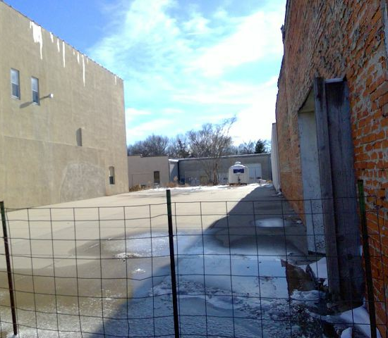
Example:
Vacant downtown lot has current value of $15,840
Improvements are made so that when work is done, county assessor assigns total value of $225,000
Resulting in increase in value of $209,160
Current total tax rate is $1.724617/$100 of value
Increase in property tax per year = $3,607
Total potential TIF = $3,607 X 15 years = $54,105
Taxes on base value of $15,840 still go to all the taxing entities

Slide 14
preparing for TIF in your Community

Slide 15
Questions you need to be able to answer:
1. Who will make the decisions about TIF in your community?
2. What property in your community should be eligible for TIF?
3. What goals do you want to accomplish with the use of TIF in your community?
4. Who will be your legal representative?

Slide 16
1. Who will make the decisions?
Community Development Agency (§18-2101.01)
By ordinance
Consists of the governing body of the municipality
Community Redevelopment Authority or Limited Community Redevelopment Authority (§18-2102.01)
By ordinance or by community ballot
Appointed board of 5 or 7 members, in staggered terms, by the Mayor or City Manager (in a City Manager form of government)

Slide 17
2. What property will be eligible for TIF?
Property must be designated Blighted and Substandard
Maximum limited by classification of municipality (§18-2103(3))
Villages – 100%
Second Class City – 50%
Metro, Primary and First Class City – 35%
Exceptions for formerly used defense sites and good life districts
Property must have a general redevelopment plan adopted
Typically prepared at the same time and contained in the same document

Slide 18
Blight and Substandard Study/ General Redevelopment Plan
Typically done by a consultant
Makes findings that show how the property identified meets the definitions of Blight and Substandard as described in law (§18-2103(3))
Process for adopting the study (§18-2109)
Reviewed by the Planning Commission at a public hearing, with a written recommendation submitted to the governing body within 30 days after the public hearing
Review by the Governing Body at a public hearing, followed by adoption of a resolution that declares property blighted and substandard

Slide 19
What is proper notice of public hearing?
Hearing must be held at least 10 days from the last publication of the notice (§18-2115.01(b))
Published at least once a week for two consecutive weeks in paper of general circulation.
Copy of the report must be posted on the City’s website or made available for public inspection at a location designated in the City (§18-2109(4)).

Slide 20
What is proper notice of public hearing?
Public hearing notice (§18-2115.01)
Must be published and distributed to taxing entities
Must contain certain information (see next slide)
Notice must be provided to:
Any registered neighborhood association within one-mile radius of area to be declared B/S
President or chairperson of the governing body of each county, school district, community college, educational service unit, and natural resources district

Slide 21
Public Hearing Notice – Contents (§18-2115.01(1(d))
For Blight and Substandard declaration
Time, date, place, and purpose of hearing
A map of sufficient size to show the area being considered
Information on where to find a copy of the study

Slide 22
3. What do you want to accomplish?
Not a requirement, but is a good practice
Develop a guidance policy document
Should be adopted by the governing body
Gives the decision makers “bumper rails” for TIF
Provides backup in conversations with developers
Keeps TIF in line with what the community wants

Slide 23
What is in a TIF Guidance Policy?
TIF Committee
Application Process
Use of TIF Funds
General Approval Process
Who will finance a project (hold the note)? When will your community do that?
Policy Statement
In Wahoo we have these priorities in this order: 1) Job creation, 2) Development of vacant land, 3) Commercial rehabilitation, 4) Retail use, and 5) Residential infill
Often has application form or requirements

Slide 24
4. Legal Representative
Will this be your City Attorney or will this be outside counsel?
How will they charge?
Lump sum for the project or hourly
How will you recover this cost?
If outside counsel, do their practices align with your community goals?
Are they very liberal in their interpretation of the Community Development Law?
Are they conservative?
Does this align with how your community wants to use TIF?

Slide 25
CLERK ALERT:
TIP: Create a binder for each Blight and Substandard Study/General Redevelopment Plan you’ve adopted
Plan
All approval process documents
Presentation information
TIP: Copy or print off a calendar when scheduling your process
Mark your regular public meeting dates
Mark your posting and publication deadlines
Add these deadlines and dates to your calendar
TIP: Create mailing labels for taxing entities – print several copies and use on mailing forms

Slide 26
project development and management

Slide 27
How is a project initiated?
Developer request
Community project – use an RFP Process

Slide 28
Application – Wahoo’s Examples
2022-05-10 - Wahoo TIF Application
2022-05-10 - TIF Application Worksheet

Slide 29
We have a project!
Project Development
Project Approval
Project Management
2. Detail Negotiation
3. Legal Document
1. Timeline
2. Approvals
1. Note Issuance
2. Tracking Deadlines
1. TIF Committee
3. Notice to County Assessor
So now what????

Slide 30
Project Development
Need completed application submitted
Once you have the application – schedule TIF Committee meeting
Will likely need a couple meetings – at least one should include the redeveloper
Put the attorney on notice of an upcoming project
TIF Committee:
Committee will likely have questions for the redeveloper but also need the opportunity to speak candidly about the project.
These meetings are not open to the public.
Having people who know what the community goals are and can vocalize these on the committee is good!

Slide 31
Negotiations of details
One of the most difficult parts of TIF
Redevelopers will need it yesterday
Redevelopers will want more than what you can offer
Sometimes politics will be involved
Rely on your TIF Policy
Do not advance until this is done

Slide 32
Legal representation – preparation of documents
Your legal representation sometimes does some of the negotiating, especially in larger projects.
They must be comfortable with what you want to do because they have to represent you.
If you community knows what they want before sending it to an attorney, you can sometimes get a better deal.
It’s going to be expensive. It is a recoverable expense.
Their job is to help you protect your community.

Slide 33
Legal Representation – Preparation of documents
Don’t be afraid to get creative.
Make sure you review the documents.
Give the attorney your standard meeting schedules and publication dates in advance.
Layout a timeline with them so all expectations are expressed and able to be met.
Do not advance until all parties agree the documents are correct.

Slide 34
Project Documents
Amendment to the General Redevelopment Plan showing the specific project to ensure project is in conformance with municipal planning
Cost benefit analysis for each project (§18-2113)
Looks at tax shifts
Impact to public infrastructure, community public services, and local tax impacts
Impact on employers and employees of new or expanding firms as well as existing firms in the community or in the immediate area
Impacts on student populations of school districts in the city or area
Any other relevant impacts
Redevelopment Contract

Slide 35
Project Approval Process
Recommendation of approval from the Authority
Recommendation from the Planning Commission
Approval by the Governing Body

Slide 36
What is proper notice of public hearing?
Hearing must be held at least 10 days from the last publication of the notice (§18-2115.01(b))
Published at least once a week for two consecutive weeks in paper of general circulation.
Copy of the report must be posted on the City’s website or made available for public inspection at a location designated in the City (§18-2109(4)).

Slide 37
What is proper notice of public hearing?
Public hearing notice (§18-2115.01)
Must be published and distributed to taxing entities
Must contain certain information (see next slide)
Notice must be provided to:
Any registered neighborhood association within one-mile radius of area to be declared B/S
President or chairperson of the governing body of each county, school district, community college, educational service unit, and natural resources district

Slide 38
Public Hearing Notice – Contents (§18-2115.01(1(d))
For Redevelopment Plan
Time, date, place, and purpose of hearing
A map of sufficient size to show the area being considered
Where to find a copy of the cost-benefit analysis (must be posted on the City’s website or made available for public inspection in a designated location)

Slide 39
Approval documents
Resolutions – approved by
Authority (CDA or CRA)
Planning Commission
Governing Body
Prepared by your legal representative

Slide 40
It’s approved… now get the signatures!
Should go without saying but this is an important step!
Make sure all blanks are filled in on the agreement, all documents signed.
Scan and send a copy to your legal representation and to the redeveloper
Do not issue the note until all signatures are collected

Slide 41
Project Management – Issuance of Notes
At the back of a redevelopment agreement there is an example of a Promissory Note.
The Redevelopment Agreement states when this should be issued.
The holder of this note can use it to secure financing for the project improvements.
Redeveloper often takes the note to a bank to use it as collateral for a loan
Redevelopers can hold the note themselves if they have the capital to complete the project already… basically investing in themselves.
City can hold the note as well.
City’s preference can be defined in the TIF Policy/Guidance Document

Slide 42
Project Management – Tracking Deadlines
There are deadlines described in the agreement
Put these in your calendar
Track them
Inquire if redeveloper is getting close to a deadline
Report any concerns to your City Attorney or to your Governing Body

Slide 43
Project Management – Notice to County Assessor
It is your responsibility to provide notice to the County Assessor of the division of taxes on a property
https://revenue.nebraska.gov/sites/default/files/doc/pad/forms/Notice_to_Divide_Tax_for_TIF.pdf
Must be filed “On or before August 1 of the calendar year that the division of the real property tax becomes effective, the city/CRA must complete the required information specified on this Notice for each new TIF project and file the Notice and the required documents with the county assessor”
Redevelopment Agreement defines the “effective date”.

Slide 44
CLERK ALERT:
TIP: DO NOT FORGET to file the Notice to Divide Taxes. Leave yourself MANY notes in various locations with various people.
TIP: Create a binder for each Redevelopment Project
Redevelopment Plan Amendment
Redevelopment Agreement
Promissory Note
Notice to Divide Taxes
Copies of your agreement and invoices for legal fees
All approval process documents
Presentation information

Slide 45
CLERK ALERT:
TIP: Copy or print off a calendar when scheduling your process
Mark your regular public meeting dates
Mark your posting and publication deadlines
Add these deadlines and dates to your calendar
TIP: Create mailing labels for taxing entities – print several copies and use on mailing forms
TIP: Prepare your Governing Body for how much the legal fees will be
TIP: Include notices of posting and agenda in your binder
TIP: Distribute the information to your board early. Do not wait until 2-3 days before the meeting

Slide 46
after the project is complete

Slide 47
Certificate of Completion
Document signed and submitted by the redeveloper or their engineer/architect stating that all work has been completed as per the terms of the agreement
Must be accepted by the Authority

Slide 48
Certification of Eligible Project Costs
Redevelopment Agreement spells out what the TIF eligible expenses are
Redevelopment Agreement states how much those will be
Find that page in the Agreement
Also likely in the cost-benefit analysis

Slide 49
Evidence
Invoices
Documents
Contracts
Check stubs
Releases

Slide 50
Approval Required of Cost Certification
Form must be submitted and signed
Must have the necessary supporting documents
THEN Must have Authority approval

Slide 51
TIF – Payments
1. Redeveloper will pay their ENTIRE tax bill, just like if TIF was not a thing. Still due at the same time. Still subject to penalties.
2. County Treasurer will break out that tax payment between the base value and the incremental increase.
3. The taxes on the base value will be distributed to each taxing entity as normal.
4. The taxes on the incremental increase will ALL come to the City.

Slide 52
Payments from County Treasurer
Each Month you will receive a property tax remittance statement

Slide 53
Payments to Redevelopers or Note Holders:
Find a process that works for you
In Wahoo payments are processed monthly
Payment approval to the redeveloper is part of our normal claim approval process
THE REDEVELOPER NEVER GETS MORE MONEY THAN WHAT IS PAID IN – WHETHER THAT IS IN THE FORM OF PROPERTY TAXES OR PROPERTY TAX CREDITS.
THE REDEVELOPER NEVER GETS MORE MONEY THAN WHAT IS ALLOWED BY THE REDEVELPMENT AGREEMENT.
THE REDEVELOPER NEVER GETS PAYMENTS FOR LONGER THAN THE TERMS DESCRIBED IN THE REDEVELOPMENT AGREEMENT.

Slide 54
Sample Worksheet

Slide 55
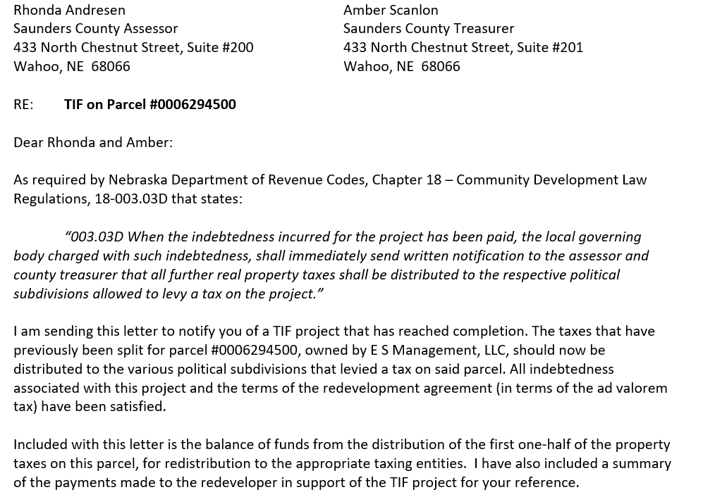
Project End
When the terms of a Redevelopment Agreement have been met the County Assessor and County Treasurer Must be notified.

Slide 56
Project End: Sample Worksheet

Slide 57
CLERK ALERT:
TIP: Keep a list of the Parcel ID#s for the various TIF Projects you have in your community
Use the “Nebraska Taxes On-Line” to help you determine exactly who is paying their taxes each month. The taxes on the base amount will be broken out from the taxes on the incremental increase value.
https://nebraskataxesonline.us/ (Parcel ID 0002063501)
TIP: Keep a binder of all your TIF project payment records. Keep the County Assessor statement you get each year in that binder. Keep a current worksheet of receipts/payments/balances. Keep payee information in there.

Slide 58
CLERK ALERT:
TIP: Do not make a payment to a redeveloper until the TIF eligible project costs have been approved by someone other than you. CYA.
TIP: Make the payment process to the redeveloper part of your monthly process. Waiting only creates phone calls and messes up your record keeping.
TIP: Send a copy of the receipts/payment register for the project with the check. This states EXACTLY how much more money they have coming to them.

Slide 59
reporting requirements

Slide 60
December 1 – Report to State Property Tax Administrator (§18-2117.01)
Copy of the redevelopment plan and any amendments
Date of approval
Effective date
Location and boundaries of the property
Short narrative description of project – including financing and type of business
* Must be filed each year except for the redevelopment plan, unless amended

Slide 61
Wahoo Example – December 1 Report

Slide 62
May 1 – Annual Report to taxing entities (§18-2117.02)

Slide 64
Statute is very specific on what must be included
Post on your website for full transparency
Send report to each taxing entity

Slide 65
Additional Detailed Report
Detailed report to Council and made available on City website
Contains details on each project – and payments made each year
Contains comparison to our peer communities
Contains our TIF Guidelines/Policy
General Annual Summary for the Council

Slide 66
CLERK ALERT:
TIP: There is no shame in copying a format you like from another entity. Why reinvent the wheel?
TIP: Keep it simple. Maybe your Council or Board is not interested in the same details mine is.
TIP: Put these deadlines in your calendar. Make them part of your process.
TIP: Pay attention to League Bulletins or information on law changes that happened during the Legislature. They are always tweaking something!

Slide 67
CLERK ALERT: RECORDS MANAGEMENT
§18-2117.04 States:
“On and after October 1, 2018, each city that has approved one or more redevelopment plans or redevelopment projects that are financed in whole or in part through the division of taxes (as provided in 18-2147) shall retain copies of
A) all such redevelopment plans
B) all supporting documents associated
with the redevelopment plans or redevelopment projects,
with any related substandard and blighted declaration
with any related extremely blighted declaration

Slide 68
RECORDS MANAGEMENT – page 2
For either
The period of time required any under applicable records retention schedule adopted under the Records Management Act, OR
Three years
Whichever is longer
Supporting documents include:
Any blighted or extremely blighted study or analysis conducted
Any cost-benefit analysis conducted
Any invoice, receipt, claim, or contract received or generated by the city that provides support for receipts or payments associated with the plan or project

Slide 69
MICRO TIF

Slide 70
Recent program added
Micro TIF
Must adopt a resolution to authorize use of this program
Application is very simple – form provided by NDED

Slide 71
EXAMPLES

Slide 72
Wahoo Projects Successful…

Slide 73
Omaha Steel Castings

Slide 74
Bomgaars

Slide 75
Sid Dillon’s Chevrolet

Slide 76
Wahoo State Bank

Slide 77
JEO Consulting Group

Slide 78
Wahoo Locker

Slide 79
Wahoo Projects Not So Successful…

Slide 80
Rock Creek Fur
Wahoo Housing Partners
Chestnut Neighborhood North
Wahoo Super

Slide 81
Simple Explanation - Video
https://youtu.be/yH4uIBcj-Y0?feature=shared

Slide 82
Things I don’t know about
Extremely blighted area (§18-2101.02)
Workforce housing
Natural disaster areas
Redevelopment Project with multiple projects
These are topics you should do your own research on as they were not covered in this session.

Slide 83
QUESTIONS?
Thank you for your attention and time!

